Slide 1
DAH2F3 Perencanaan Sumber Daya Perusahaan
Minggu ke-7: Financial Accounting
P r o d i D 3 K o m p u t e r i s a s i A k u n t a n s i F I T , U n i v e r s i t a s T e l k o m

Slide 2
AGENDA
Lesson: SAP R/3 Accounting
Accounting Foundation
Reference:
Monk, E., & Wagner, B. (2009). Concept in Enterprise Resource Planning Third Edition. Boston, Massachusetts: Course Technology Cengage Learning.
SAP. (2006). SAP01: SAP Overview. SAP AG.
Financial Accounting
Management Accounting

Slide 3

Accounting Foundation
Play Video
Notes:
Basic Accounting https://www.youtube.com/watch?v=HQKV47sDpOY

Slide 4
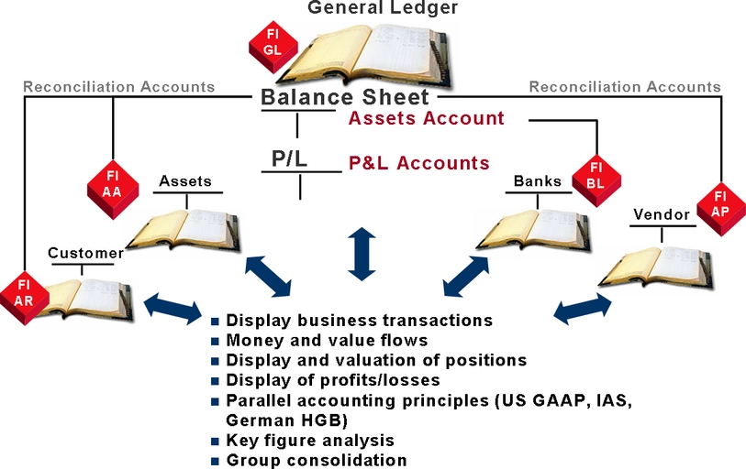
SAP R/3 Accounting System Financial Accounting
Notes:
Reconciliation account will come under Chart of Account. The customer account will come under General ledger. The customer / Vendor account will be reconciled by the reconciliation a/c.

Slide 5
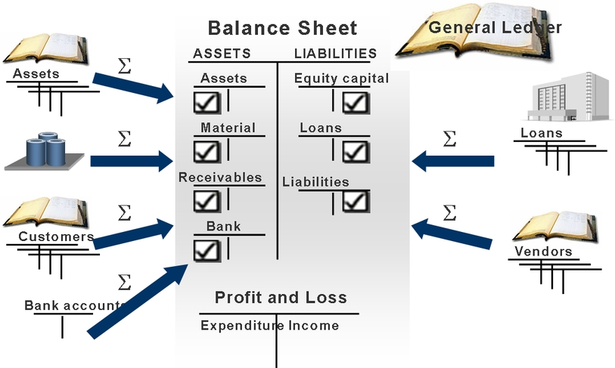
SAP R/3 Accounting System Balance Sheet and Profit and Loss Statement
Notes:
Akuntansi → menghasilkan laporan keuangan → dilihat oleh pihak lain → bahan untuk menarik investor, laporan pajak dll.
Tapi ternyata akuntansi bisa dimanipulasi dan rawan PENIPUAN. Next slide.

Slide 6

Fraud
Accounting
vulnerable to
Play Video
Notes:
Enron https://www.youtube.com/watch?v=stwcqdk7C_w
Kasus penipuan terjadi di perusahaan ke-6 terbesar di US.

Slide 7

Fraud
Preventing
Play Video
Notes:
Sarbanes oxlye http://www.youtube.com/watch?v=xW9pSAwaeO0
Dibuat aturan yang mencegah adanya PENIPUAN .
Sarbanes oxlye = SOx

Slide 8
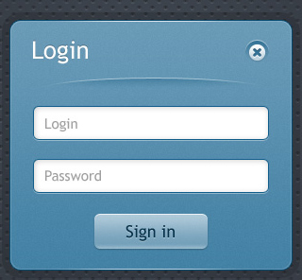




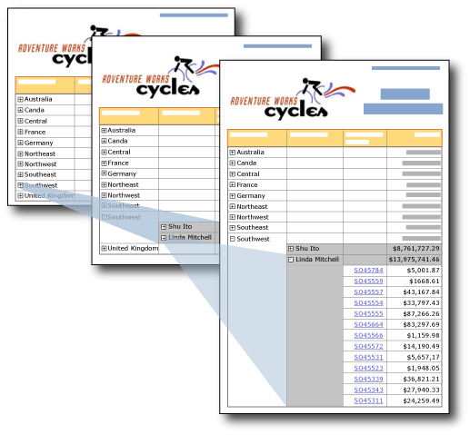
Archiving
User Authorizations
Tolerance Groups
Financial Transparency
Notes:
SAP sudah memenuhi aturan Sox dengan:
Archiving
The software offers very few ways to delete items.
No deleting - the closest option is to flag for deletion.
Data are removed from the SAP ERP system only after they have been recorded to media (tape backup, DVD-R) for permanent storage.
User Authorizations
SAP ERP has sophisticated user administration tools that allow different levels of authorization management, to ensure that employees can perform only the transactions required for their jobs.
Tolerance Groups
Another ERP way to make sure employees do not exceed their authority in financial transactions is to set limits on the size of transaction an employee can process.
Financial Transparency
drill down from a report to the source documents (transactions) that created it

Slide 9
SAP R/3
What’s this stand for?
“R/3″ for “Realtime” and “3 tier” processing architecture.
What is this?
Enterprise wide information system. Integration of various aspect of accounting.
What does it do?
Provide accounting data
Processing operational data for strategic company decision

Slide 10
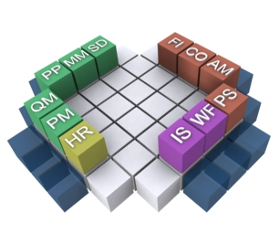
SAP SD (Sales & Distribution)
record sales and creates and
accounts receivable (AR) entry
SAP FI (Financial Accounting)
manages the AR and AP items
G/L Closing
SAP MM (Materials Management)
purchase order creates and
accounts payable (AP) entry
SAP CO (Controlling)
tracks the costs associated
with producing products
SAP AM (Asset Management)
manages fixed-asset purchases
(plant and machinery) and
the related depreciation.
SAP R/3 integration
with other modules
SAP HR (Human Resources)
manages the recruiting, hiring,
compensation, termination,
and severance of employees.
Sumber : http://www.wiki.sapamericas.com/wp-content/uploads/2013/02/SAP-Modules.jpg
Chp 5 p122
Notes:
PP : Production Planning
QM : Quality Management
PM : Plant Management
PS : Project System
WF : Workflow
IS: Industry Solution

Slide 11
SAP R/3 Accounting System
SAP R/3 Accounting System offers:
Flexibility software for different countries
Meets major industrial nation needs
Multilingual approach
Currency handling
Country-specific functions for taxes
Reporting and payment transaction

Slide 12
SAP R/3 Accounting System
Component
Organizational Element *)
Financial Accounting (FI)
Corporate Finance Management
Profitability and Sales Accounting
Product Cost Controlling
Overhead Cost Controlling
Investment Management (IM)
Project Management
Corporate Group
Company /Client
Company Code
Business Area
Functional Area
Profit Center
*) Please recall previous slide on Organizational Element

Slide 13
Chart of Accounts
What is CoA?
Is a classification system defined by accounting to record values or values flow.
1 company code = 1 CoA

Slide 14
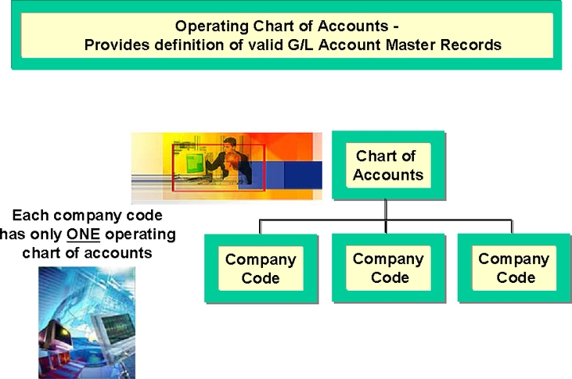
Chart of Accounts

Slide 15
Chart of Accounts: 3 Function
As an operational CoA
Account used in day-to-day transaction (financial accounting and cost accounting)
As an local CoA
Account for legal requirement (country specific)
As a group CoA
Account applied throughout the corporate group to standardize operation within a corporate group.

Slide 16
Master Data
Customer
Vendor
Assets

Slide 17
Customer Master A/R
Contain information about Customers such as Payment and dunning.
Features which characterized customer master records:
Provides an overview of all of a customer’s data at any time
Allows flexibility access to the data
Forms the database that controls automatics dunning and automatics payment transaction
Notes:
A/R Account Receivable

Slide 18
Customer Master A/R
3 Structure of Customer Master Record
General Data
Data for Company Code
Data for Sales
Notes:
General Data → data yang relevan untuk semua company code dan sales organization [nama, alamat, bahasa]
Data for Company Code → data agreement sesuai dengan company-specifics [parameter pembayaran, akun G/L, dunning/penagihan]
Data for Sales → spesifik untuk sales org dan dist-channelnya [selling/shipping, Billing]

Slide 19
Vendor Master A/P
Contain information about Vendors
Features which characterized customer master records:
Overview of all data for a given vendor
Flexible data access
Baseline data used to control payment transactions and to represent business process.
Notes:
A/R Account Receivable

Slide 20
Vendor Master A/P
3 Structure of Customer Master Record
General Data
Data for Company Code
Purchasing organization data
Notes:
General Data → data yang relevan untuk semua company code dan sales organization [nama, alamat, email, fax, corporate group, cabang, bank details]
Data for Company Code → data agreement sesuai dengan company-specifics [parameter pembayaran, akun G/L, dunning/penagihan, correspondent information, payment method]
Purchasing Organization data→ inquiry, order, invoice verification information. Can be amended anytime you want

Slide 21
Assets Management
Fixed assets need to be planned and monitored.
To maintain Assets
Chart of Depreciation
Represent valuation methods for commercial balance sheet, tax requirement, controlling purpose, corporate policy, etc.
Notes:
Mampu memberikan perhitungan dengan berbagai metode penilaian depresiasi untuk kebutuhan pelaporan neraca, kebutuhan pajak, tujuan kontroling atau kebijakan dan aturan perusahaan
berdasarkan waktu:
i. metode garis lurus (straight line method) ii.
metode pembebanan yang menurun
• metode jumlah angka tahun (sum of the years digit method)
• metode saldo menurun (declining balance method)
b. berdasarkan penggunaan
metode jam-jasa (service hours method)
ii. metode jumlah unit produksi (productive-output method)
c. berdasarkan kriteria lainnya
metode berdasarkan jenis dan kelompok (group and composite method)
ii. metode anuitas (annuity method)
iii. sistem persediaan (inventory method)
Penyusutan → beban → laba rugi → laba sedikit → pajak sedikit

Slide 22
Assets Management
Classification fixed assets: Assets class
Classification criteria
Depreciation keys and useful life
Valuation net assets
Insurance-related data
Assets type (assets under construction, low value economics unit, lease assets, and capitalized assets)
Notes:
Dalam asset management terdapat asset class
Dalam asset class terdapat data-data sebagai berikut:
kriteria klasifikasi Kunci Penyusutan dan masa manfaat Penilaian aset bersih Data yang terkait Asuransi- Aset Jenis (aset dalam pembangunan, satuan nilai ekonomi rendah, aset sewa, dan aset dikapitalisasi)

Slide 23
Account Balances
Overview of a line item display:
Open
Cleared
Parked
Line item display available for:
An account in a company code
An account group in a group of company codes (worklist)

Slide 24

Agenda
Lesson: SAP R/3 Accounting
Accounting Foundation
Financial Accounting
Management Accounting

Slide 25
Lesson: Financial Accounting
Lesson Overview
-
Lesson Objectives
Explain how SAP supports the key process in financial accounting
Describe how to create a payment, view a general ledger transaction, and view a bank balance

Slide 26
General Ledger
Activity:
Operational transactions
eq. goods issue cause material issue posting
Posting transaction in subsidiary ledger
eq. assets acquisition in fixed assets
Transaction originally assigned to the G/L
Posting G/L
Notes:
Posting pada general ledger bisa disebabkan oleh aktivitas:
Transaksi operasional
Transaksi posting pada subsidiary ledger (buku pembantu), contoh buku pembantu
Contoh: beberapa buku pembantu sbb: - Buku pembantu piutang - Buku pembantu persediaan bahan baku dan penolong - Buku pembantu mesin dan alat - Buku pembantu utang - Buku pembantu biaya overhead pabrik - Buku pembantu biaya administrasi dan umum - Buku pembantu biaya penjualan

Slide 27
General Ledger
G/L Posting
SAP MM
FI-AA
FI-GL
FI-CO
eq. assets acquisition in fixed assets
Transaction originally assigned to the G/L
eq. goods issue cause material issue posting

Slide 28
General Ledger
Subsidiary ledger are integrated with G/L accounting on level master data, transaction data and reporting.
Integrated → accessing shared database

Slide 29
General Ledger
Shared database means:
non-redundant data creation and maintenance
Documentation and review system that can be clearly verified at any time
Complete access to all application
Reporting information system that can be fully customized

Slide 30
Accounting Documents: Type
Original Document
Processing Document
Receipts
Invoices
Checks
Bank Statements
Accounting Documents
Sample Documents
Recurring Entry Documents
Notes:
An invoice is a bill, or a request for payment, for a sale. It lists goods or services provided by the seller to the customer, along with prices, credits, discounts, taxes and total due.
A receipt is documentation that payment has been made to finalize a sale. It serves as proof of ownership in most cases.

Slide 31
Accounting Documents
You can only check whether postings are correct in the compact journal and general ledger by means of document.
Every posting must therefore have a document.
A document consists of a document header and at least two line items.
Amount, account number, credit/debit assignment, etc
Notes:
Document header is valid for all types of the documents which is top part of the document while posting.
· Document Date
· Document Type
· Document Number
· Posting Date
· Posting Period
· Company Code
Besides the above, the document header contains information which is editable
·
· Trading partner
· Document Header Text
· Reference
· Cross Company Code number etc

Slide 32
Payment
To be able to post document
Debit and credit must balance (=Zero)
≠ Zero
What you should do? Hold or Park

Slide 33
Travel Management and Expense Reimbursement
SAP R/3 Travel management, tools for:
Plan trips
Book travel service
Approve trips
Record trips
Determine and valuate reimbursement
Account for travel expense

Slide 34
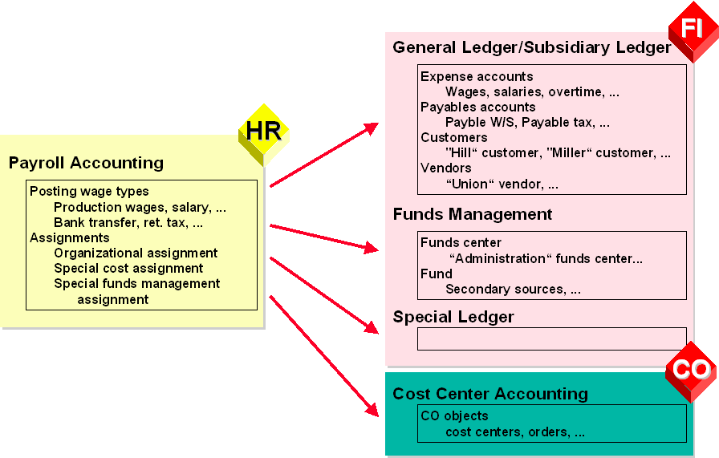
Payment and Transfer to Payroll Accounting
Payment of expense
Eq.travel expense from R/3 Travel Management
Sumber: http://help.sap.com

Slide 35

End of This Session

